Slide 1
Intel Unnati industrial training program 2024-2025
MOHAMMAD AKRAM
(BU21EECE0100083)
KOTA SAI PRADYUMNA MAHADEV
(BU21EECE0100097)

Slide 2
Problem Statement
Develop a 2d occupancy grid map of a room using overhead cameras

Slide 3
Solution
Step 1: Software installation
Install ubuntu and gazebo in our computers
Step 2: Camera Setup
Select Cameras: Use high-resolution cameras with a wide field of view
Install Cameras: Position cameras overhead to cover the entire room.

Slide 4
Solution
Step 3: stitching
Intrinsic Calibration: Use a calibration target (like a checkerboard) to determine each camera's internal parameters. Tools like OpenCV can help with this.
Extrinsic Calibration: Calculate each camera's position and orientation relative to a global coordinate system using known reference points
Step 4: Image Acquisition
Capture Images/Video: Use a software like OpenCV to acquire synchronized images or video streams from the cameras

Slide 5
Solution
Step 5: Image Processing
Background Subtraction: Remove the static background using methods like Gaussian Mixture-based Background/Foreground Segmentation (MOG2) in OpenCV.
Segmentation: Use image processing techniques to isolate the occupied regions. This can be done using methods like thresholding, contour detection, or deep learning-based segmentation.

Slide 6
Solution
Step 6: Homographs Transformation
Transform Perspective: Apply holography using OpenCV to convert the camera's perspective to a top-down view of the room.
Step 7: Occupancy Grid Creation
Define Grid: Set the size and resolution of the occupancy grid.
Map Occupancy: Mark grid cells as occupied based on the transformed segmented regions.
Step 8: Visualization
Display Grid: Use a visualization tool to display the occupancy grid, representing the room's layout and occupied areas.

Slide 7
Advantages and limitations of the approach
Pros
Comprehensive Spatial Coverage:
Top-Down Perspective: Eliminates blind spots, providing a complete view of the room.
Accurate Mapping:
Holography Transformation: Maintains spatial integrity by accurately converting perspectives.

Slide 8
Advantages and limitations of the approach
Cons :
Processing Overhead:
Latency: Ensuring low latency in real-time applications can be challenging.
Technical Challenges:
Objects or people overlapping can complicate segmentation and occupancy detection.

Slide 9
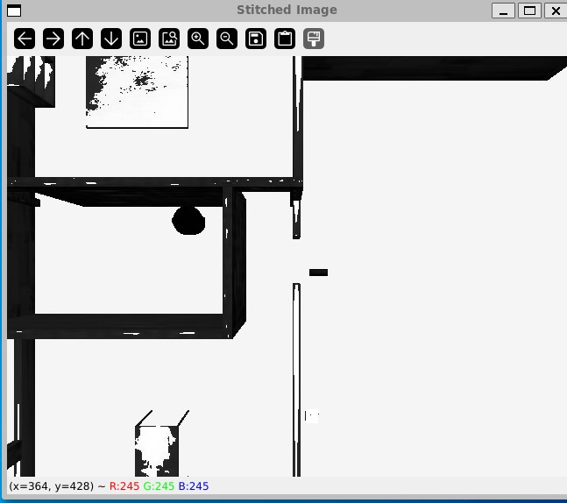
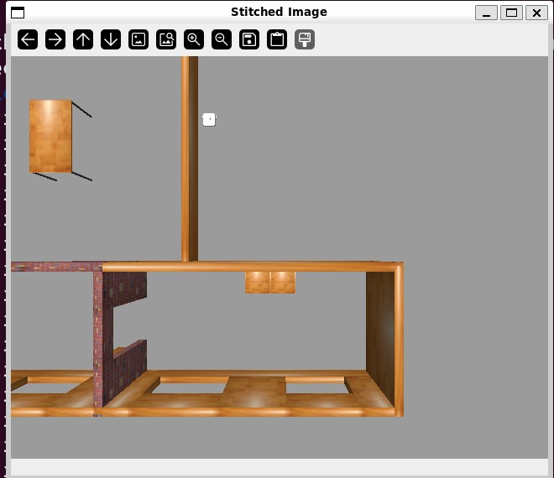
RESULT

Slide 10
SOURCE CODE: https://github.com/BTWITSAKRU/INTEL_PROJECT

